Slide 1
Mental Health Implications of the Covid-19 Pandemic
Ushmita Nana
Counselling Psychologist
www.unanapsychologist.com

Slide 2
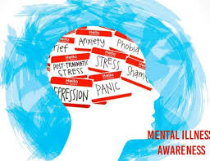
PSYCHOLOGICAL IMPACT
Widespread Psychological Distress
Financial Distress
Lack of Social Support
Unpredictability Leading to Anxiety and Depression
Inability to Access Usual Coping Mechanisms
Lack of Distraction Leading to Unresolved Experiences

Slide 3
SIGNS OF EMOTIONAL DISTRESS
BEHAVIOURS Decrease in Energy Levels Increase in Alcohol, Tobacco, Drug Use Difficulty Sleeping Becoming Quiet and Withdrawn Becoming Agitated and Angry | BODILY SENSATIONS Stomach Aches or Diarrhoea Loss or Increase in Appetite Headaches or other Pains Excessive Sweating or Chills
EMOTIONS Anxious or Fearful Feeling Depressed or Angry Feeling Overwhelmed | THINKING Difficulty Remembering Things Difficulty Making Decisions

Slide 4
COPING TOOLS
Acknowledge Feelings as Valid
Limit Media Consumption – once or twice daily
Seek Reputable Information
Reflect on Past Coping Strategies
Opposite Action – funny video or movie
Explore your Circle of Control
Stay Connected – Call Instead of Text
Recognize the Signs of Depression and Anxiety

Slide 5
WORKING FROM HOME
Initial Novelty
Work/Life Balance – Relationship Distress, Burnout
Other Challenges – Motivation, Isolation, Insomnia
Suggestions:
Routine and Structure for Work Day – Cue Work Time and Home Time
Create Work Space – Avoid Bedroom
Digital Detox Evenings

Slide 6
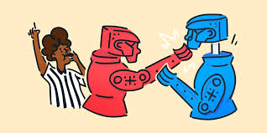
LIMITING CONFLICT
Confined Spaces May Lead to Conflict
Suggestions
Roster for Chores
Engage in Enjoyable Activities
Communicate Needs
Engage in ‘Me’ time

Slide 7
STAYING CONNECTED
Social Relationships Required for Good Mental Health
Improve Quality of Interactions by Avoiding Distractions
Virtual Dates
Online Hobby Groups
Online Stretching or Exercise Groups

Slide 8
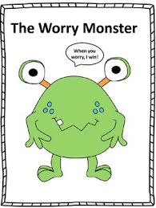
DEALING WITH CHILDREN
Behavioural Signs of Emotional Stress – clingy, bed-wetting, disruptive
Model Appropriate Reactions
Have Honest and Age-appropriate Discussions
Encourage Curiosity
Explore Creative Means of Expression – Worry Monster
Implement Routine and Structure
Introduce Stimulating Activities
Include One on One Time
Limit News Exposure

Slide 9
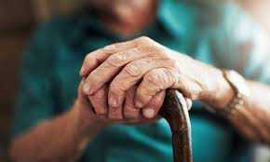
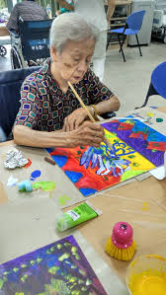
DEALING WITH THE ELDERLY
Isolation Risk Factor for Depression
Dementia Suggestions:
Regular Routines
Limit Exposure to News
Calming Activities – Music, Painting, Singing
Exercise
Keep in Contact
Photos of Friends and Family

Slide 10
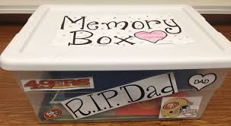
ADDRESSING GRIEF
Grief as a Normal Reaction to Loss
Complicated Grief – Extended, Severe
Sudden Death, Other Stressors, Lack of Support
Not Saying Goodbye, Rituals, Funerals
Ways of Mourning
Letter Writing
Lighting of Candle, Listening to Music
Scrap-booking, Memory Box

Slide 11
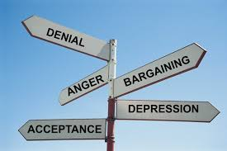
STAGES OF GRIEF
Denial – involves denying the pain for a short time
Anger – Gain control over fears, blame, hostile
Bargaining – Acknowledge reality, illusion of control
Despair – Depression sets in, hopeless and helpless
Acceptance – Acknowledge and surrender to the facts

Slide 12
SYMBOLIC GRIEF
Loss of Freedom, Livelihoods, Space
Denial - “It’s just the flu, people get the flu every year”
Anger - “Its all China’s fault…If the government did something differently”
Bargaining - “If I wear my mask I can visit my friends”
Despair – “There is no end in sight, we are all doomed”
Acceptance – “I cannot meet my friends, lets find creative ways of overcoming this challenge”

Slide 13
ENDING THE STIGMA
Be Conscious of the Language Used
Covid Case vs. Individual Being Treated for COVID
Separate the Diagnosis from the Person
People are more than their diagnosis!

Slide 14
HOPE AND RESILIENCE
Stories of Hope and Solidarity
Younger Adults Reaching Out to Elderly
Frontline Workers Cheered and Celebrated
Families Bonding
Online Support Groups
Financial Assistance
The Influence of Thoughts on Feelings

